Slide 1
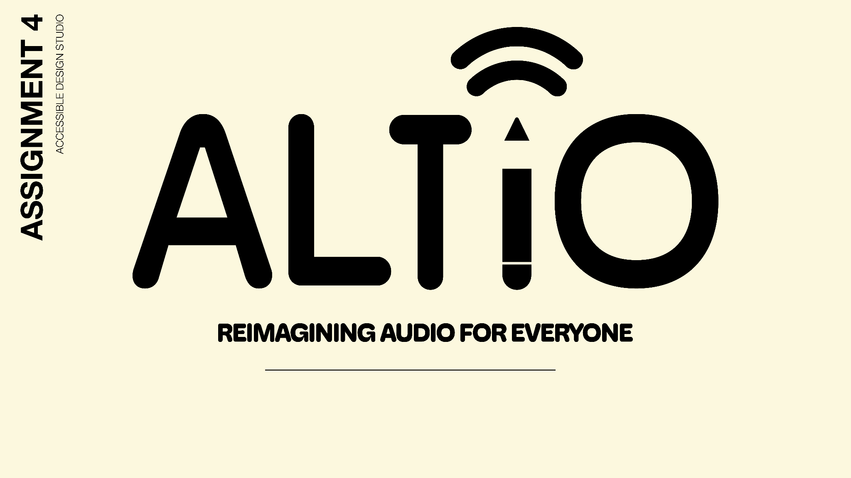
ALTiO serves to provide fun alternative audio interpretations for audio by connecting user-sourced creative expression to users in need of alternative audio. With a new, personal layer of shared interpretation, ALTiO enriches the user experience in an emotional and connective way: for one to create, and one to enjoy.

Slide 2
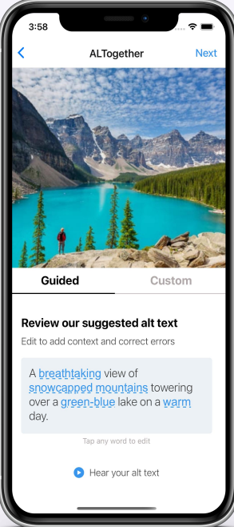
MARKET RESEARCH: ALTogether
Plug-in to encourage sighted people to put alt text on images.
Need sighted people (people without visual impairment) to create alt text.
Can be a plug-in for social media, e.g., Instagram.
Similarities
Text for images not audio (different target audience).
Alt texts benefits only people with visual impairments, while alt audio, e.g., drawings, can be enjoyed by everyone.
Differences
Good design of prompts to help people create alt text.
Good Points
The process of creating alt audio can be fun
People can share their interpretation of audio, see if the interpretation matches the audio well, and rate it.
Our uniqueness

Slide 3
TASKS
How are we reimagining audio for everyone?
SIMPLE
MODERATE
COMPLEX
Users interpret audio
Creators explain their audio interpretations
Users validate and rate audio interpretations
Users can interact with various interpretations and artists on the platform

Slide 4
Our design is centered around inclusivity, creativity, personal expression, and community.
To some extent, personal expression and inclusivity may conflict. For instance, a more abstract or personal interpretation may exclude certain people in understanding the audio to their benefit. To address this, we want to prioritize helpfulness of an interpretation to understand audio through an upvoting system.

Slide 5
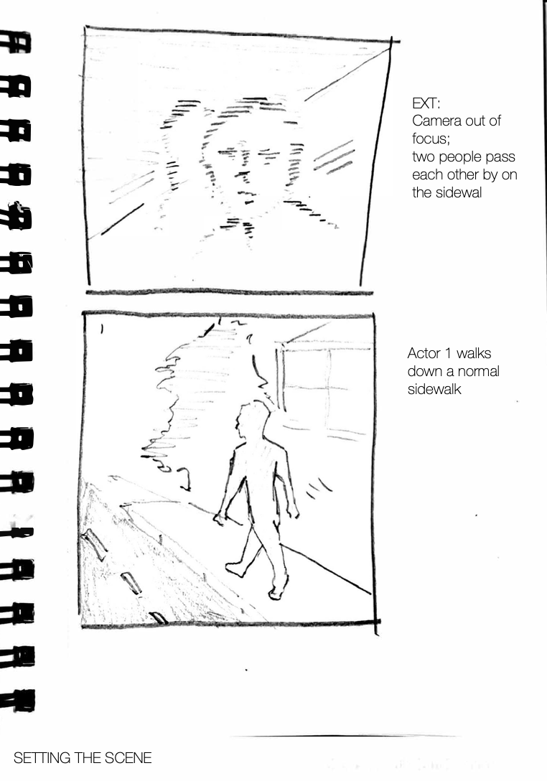
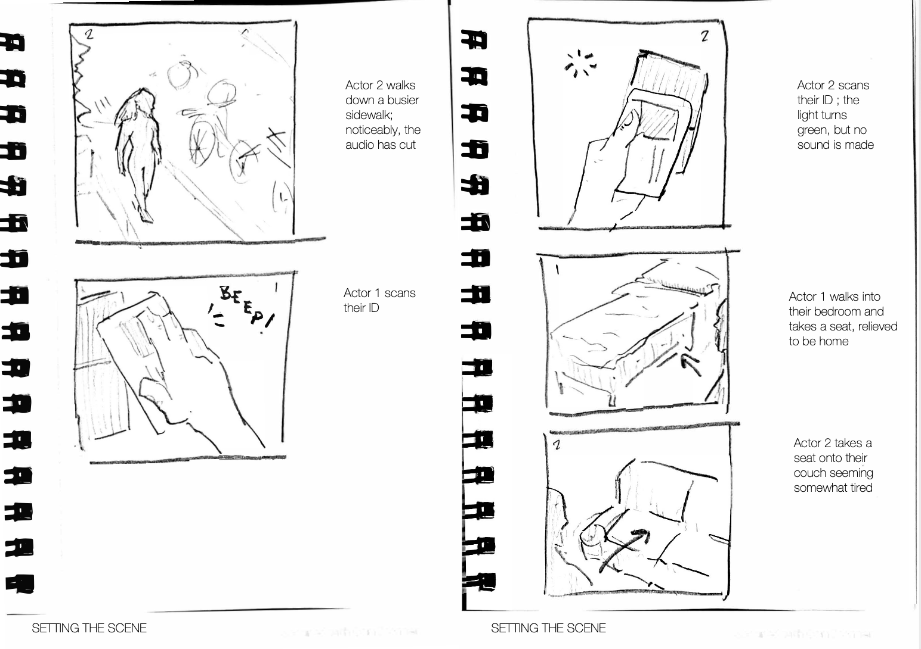
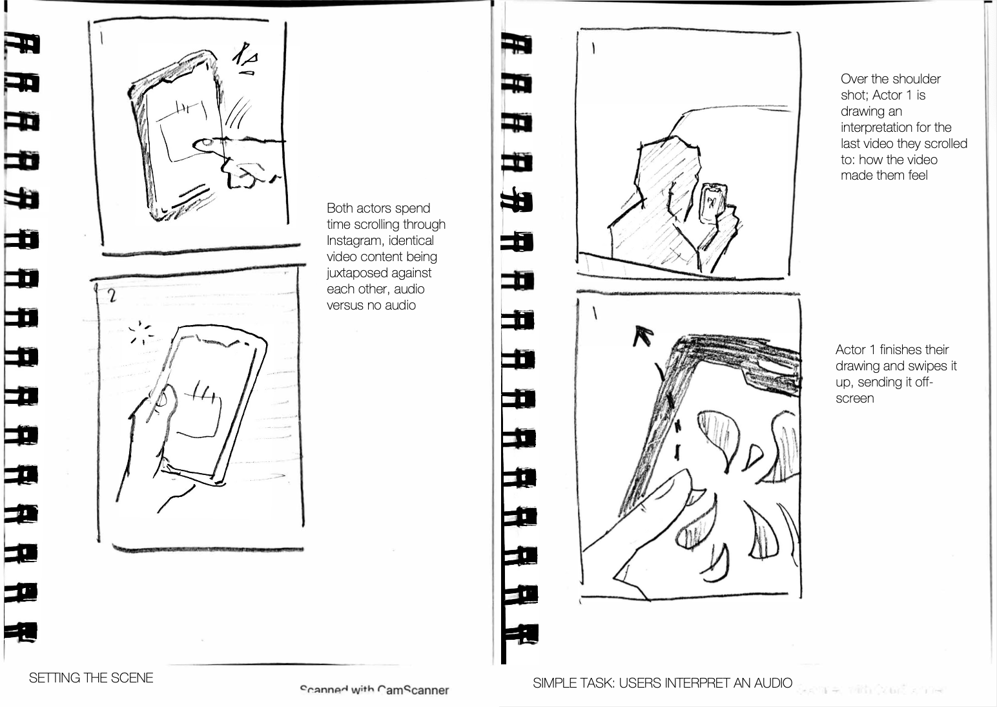
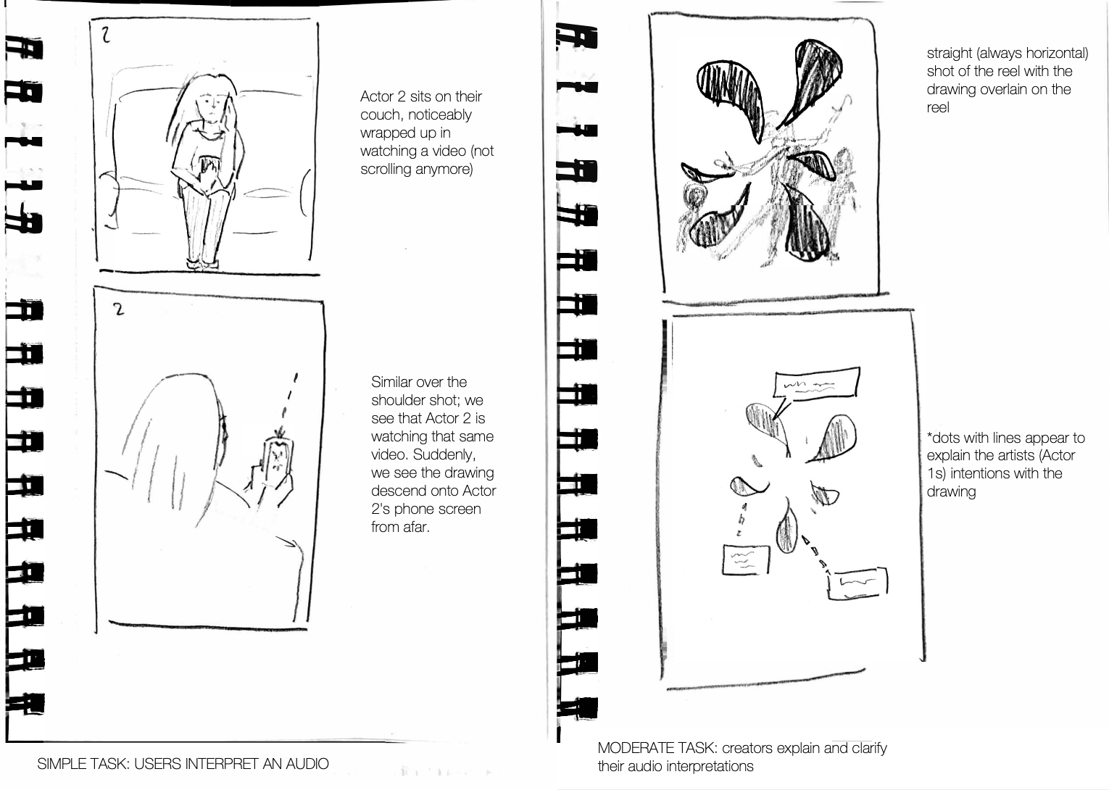
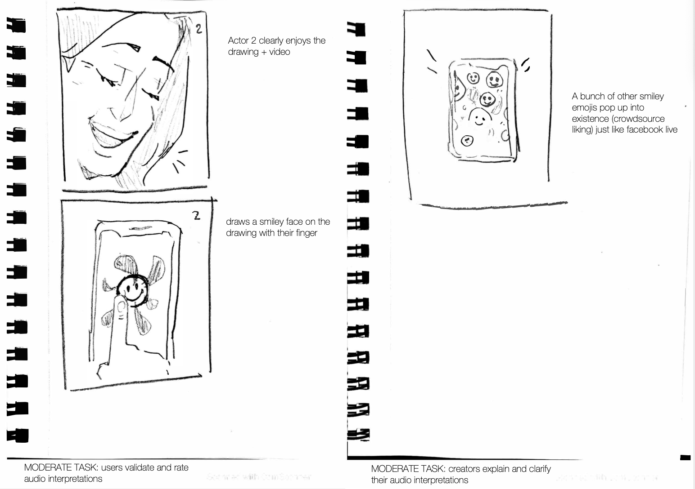
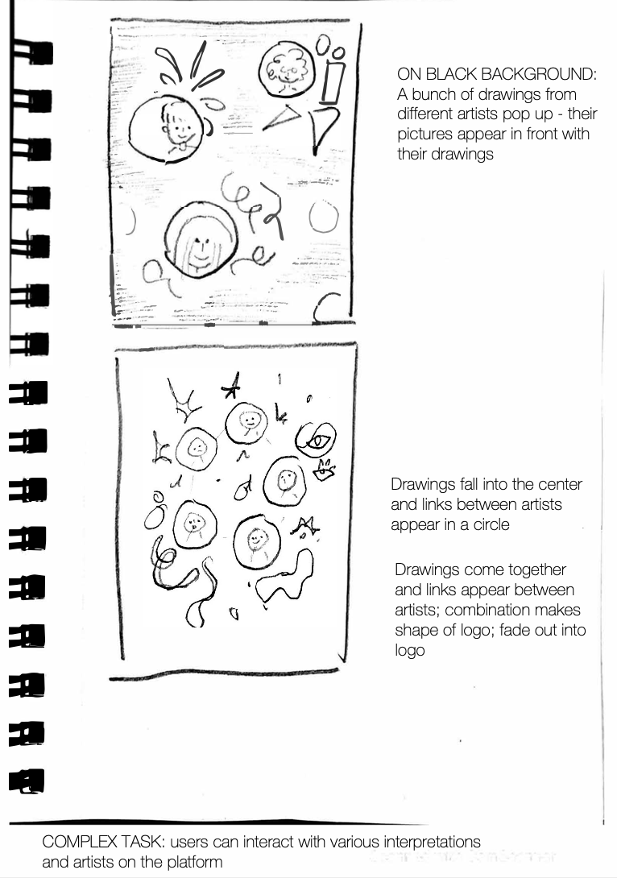
STORYBOARD
SIMPLE TASK :
MODERATE TASK :
COMPLEX TASK :

